Slide 1
Flux of Souls

Slide 2
Roles
Rudy Caliph – Scrum Master
Craig Rose – Developer
Randy Peacock – Developer
Richard Andrews – Developer
Stephan Dos Santos – Developer
Tobias Perez Davidson– Developer

Slide 3
Overview
Game Description
Changes and Project Issues/Problems
Pivotal Tracker Breakdown
UML Diagrams
Game Demonstration
Q/A

Slide 4
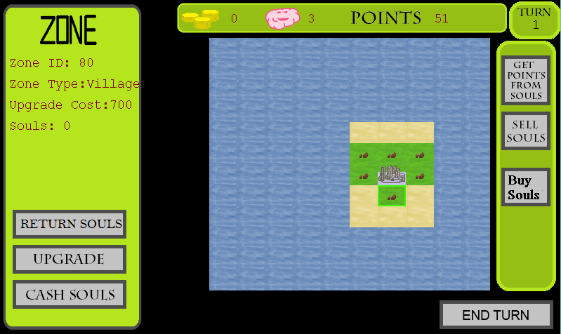
Game Description
Concept & Problem Statement
Gameplay

Slide 5
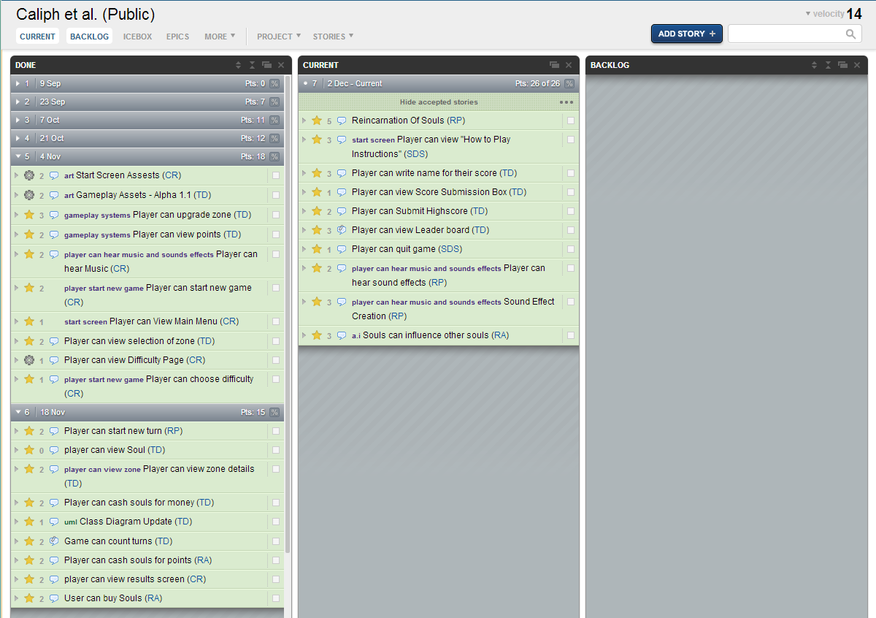
Pivotal Tracker
https://www.pivotaltracker.com/s/projects/908374

Slide 6
Changes and Project Issues
Povital Tracker
Git Hub Code Repository
Gameplay Balancing

Slide 7
Design And Analysis
Class Diagram
Use Case Diagram

Slide 8
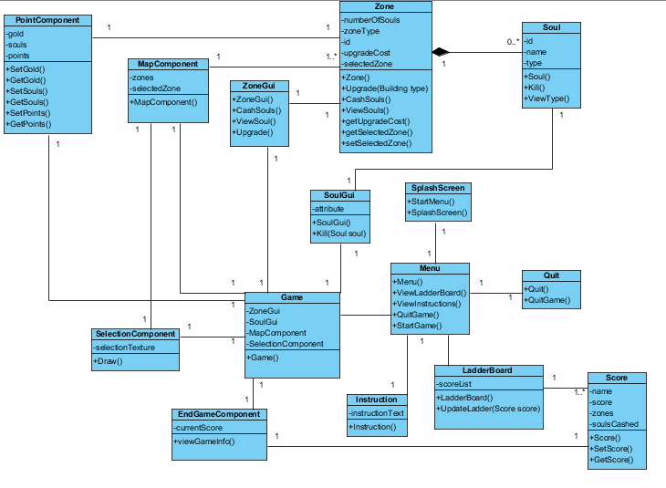
Domain Class Diagram

Slide 9
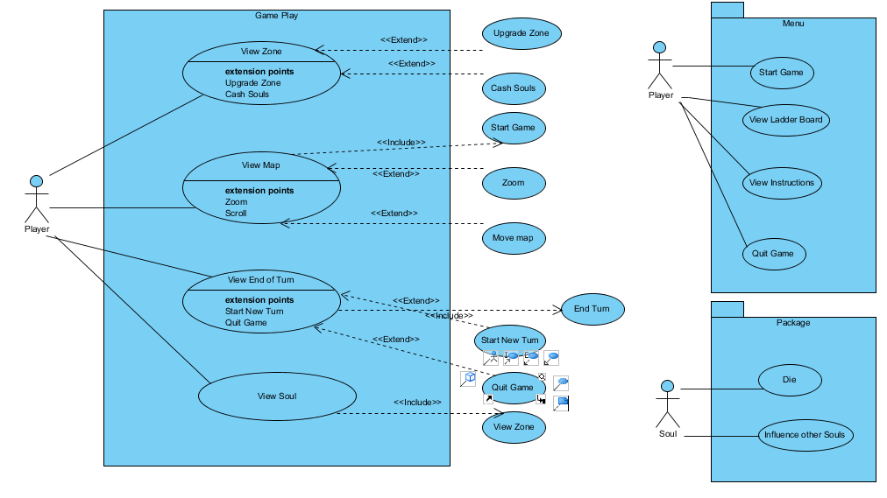
USE Case diagrams

Slide 10
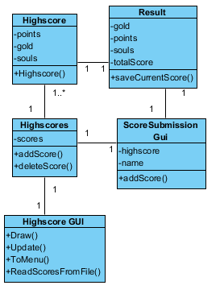
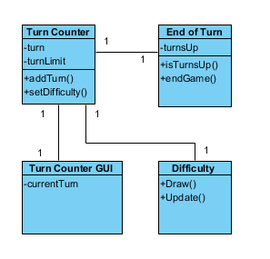
User story Class Diagrams

Slide 11
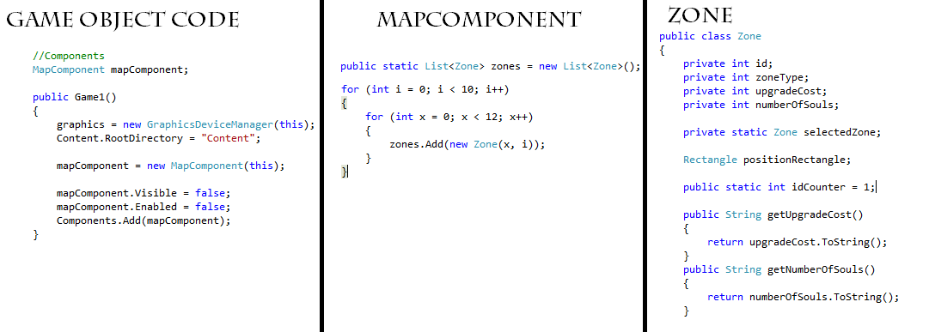
UML & Code

Slide 12

Game Demonstration

Slide 13
Question / Answer
Any questions about the project?

Slide 14
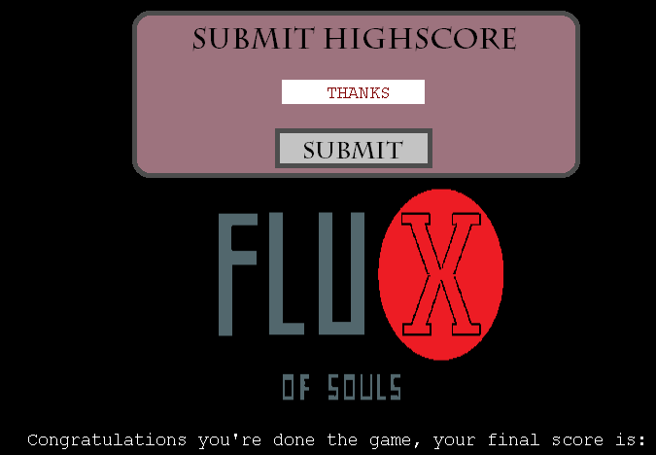
Thank you for listening

